Slide 1
Welcome
CS771: Introduction to Machine Learning

Slide 2
Course Details
Lectures: Tuesdays, Fridays, 6:30PM, L20
Website: https://www.cse.iitk.ac.in/users/purushot/courses/ml/2024-25-w/
Past Offering Question Papers: https://github.com/purushottamkar/cs771
Tutorial Videos: https://www.youtube.com/c/MLConversations
Discussion Forum: Piazza (all students will be added by instructor)
Grading Platform: Gradescope (all students will be added by instructor)
Please note that this offering is in regular mode and not flipped mode

Slide 3
Staying in Touch
Team of 23 excellent course admins (TAs)
All senior PG students working on ML foundations and applications
Office hour information on course website
All discussion, queries via Piazza – please avoid emailing instructor
Piazza allows DMs, anonym posts
If mailing instructor unavoidable, include [CS771] in the subject line
All add / drop / dual migration requests will be processed shortly
No special consideration if accepted during pre-reg and then dropped (due to Pingala issues, template issues, DUGC/DPGC action, etc)
No “adds against drops” – the course is already oversubscribed
See https://www.cse.iitk.ac.in/users/purushot/courses/ml/faq.html

Slide 4
Unregistered Auditors
Please note the two kinds of audits – registered and unregistered
See https://www.cse.iitk.ac.in/users/purushot/courses/ml/faq.html
Unregistered auditors will have access to
Lecture videos, slides, code, notes
Assignment, quiz and exam questions and solutions
We regret our inability to extend the following services to unregistered auditors
Submit assignments and receive graded submissions
Appear for quizzes, examinations and receive graded answer scripts
Please email the instructor at purushot@cse.iitk.ac.in to get enrolled as an unregistered auditor

Slide 5
Grading Scheme
20%: Quizzes
30%: Assignments
20%: Mid-sem Exam
30%: End-sem Exam

Slide 6
Quizzes
Two quizzes to be conducted – each worth 10%
Tentatively scheduled on Jan 28, 2025 (Tue), Apr 01, 2025 (Tue)
Only registered students can appear for quizzes (no auditors)
Syllabus for each quiz will cover roughly 3-4 weeks – short quiz
If you are regular with lectures, discussion hours, practice questions, then you should not have to prepare too much for these quizzes

Slide 7
Assignments – 30%
A few mini projects (individual weightages weightage TBA)
No single semester-long project
To be done in groups of 4-6 students each – 2-3 weeks for each project
Start forming your group today
Will ask you to submit group details once add-drop is over
Groups can only contain registered students (no auditors)
Create a homepage on CC/CSE home servers
Essential for project submission
Submission will include code + report
Code should be in Python – start learning Python today
Report should be in LaTeX – start learning LaTeX today

Slide 8
Extra Classes
Three (non-recess) institute holidays clashing with course schedule
14 January 2025: Makar Sankranti
28 March 2025: possible Gymkhana holiday (unconfirmed)
18 April 2025: Good Friday
Two extra classes to be held to compensate
22 March 2025 (Saturday), 6:30PM L20
12 April 2025 (Saturday), 6:30PM L20
Note that all extra classes are on Saturdays as scheduled by DoAA

Slide 9
Reference Material
No single textbook - list of reference material on course website
Python Resources: several available – choose your favourite
Beautiful resource curated by Prof. Piyush Rai https://colab.research.google.com/drive/1qmN_40NUdp6V5CQik_SRfcQ9H9IB1oZr
www.geeksforgeeks.org/python-programming-language/
LaTeX resources: several available – choose your favourite
www.overleaf.com/learn/latex/Tutorials

Slide 10
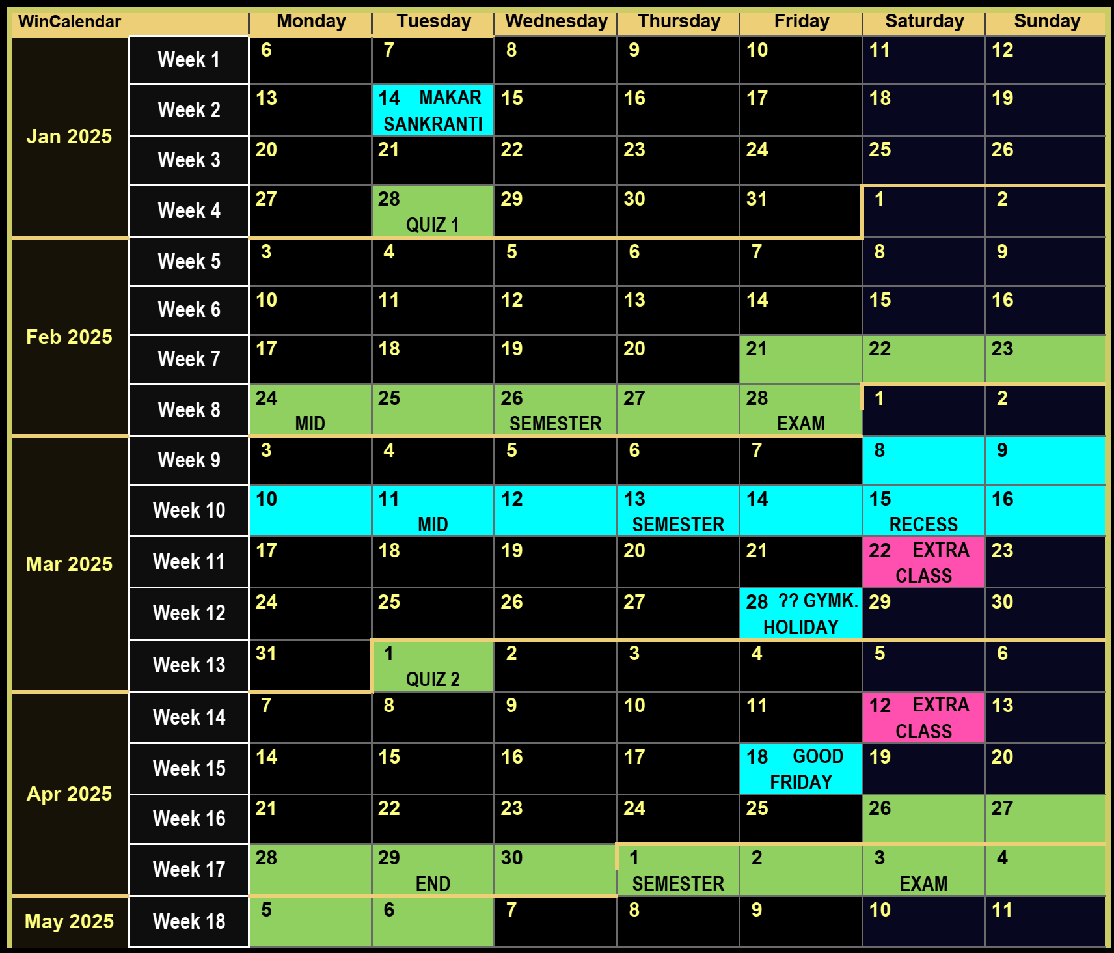





Course Website
Detailed syllabus for this course
Course calendar: schedule for holidays, exams, quizzes
Course policy: assessment, course drop, make-up
Use of unfair means, penalties and safeguards
Course etiquettes

Slide 11
A Summary of To-Dos for You
Refresh calculus, probability theory, linear algebra basics
Nice refresher by Prof. Piyush Rai https://web.cse.iitk.ac.in/users/piyush/courses/ml-autumn23/slides/maths_refresher_slides.pdf
Start learning/refreshing Python and LaTeX skills
Create a homepage on CC/CSE home servers
Start forming groups of 4-6 students – do not wait long
Students who wish to do unregistered audit
Send an email to the instructor if not already done so
Students who wish to register (credit/audit)
Apply over Pingala during add-drop – will use published policy to accept
Policy: https://www.cse.iitk.ac.in/users/purushot/courses/ml/faq.html

Slide 12
A Teaser
What is the point of machine learning?
A few cool ML apps developed by your peers

Slide 13
What is Machine Learning?
“
“
The art and science of dealing with uncertainty
The art and science of designing adaptive algorithms
ML is a way to
uncover hidden patterns in data
automate tedious and repetitive tasks
predict the future by looking at the past
deal with (continuously) evolving scenarios
At a high-level ML does this by
Looking at lots of data to examine input-output behaviour
Replicate that behaviour by writing a program

Slide 14







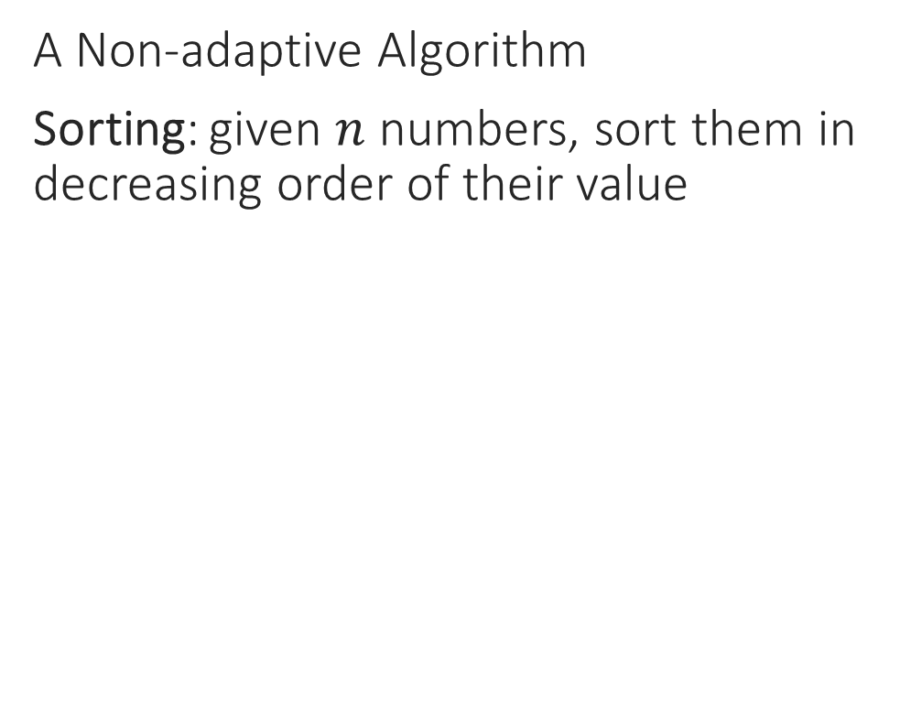
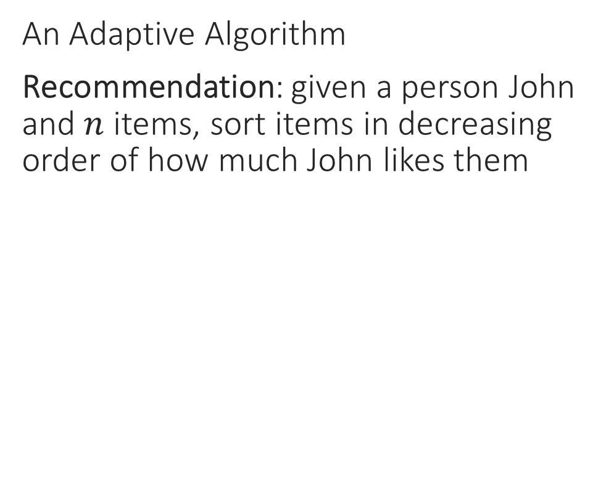
What is Machine Learning?
“
“
The art and science of designing adaptive algorithms
The art and science of dealing with uncertainty
A Non-adaptive Algorithm
Sorting: given $n$ numbers, sort them in decreasing order of their value
An Adaptive Algorithm
Recommendation: given a person John and$n$ items, sort items in decreasing order of how much John likes them
INPUT
OUTPUT
INPUT
OUTPUT
4
9
5
5
1
7
-6
4
5
5
4
1
9
4
-3
0
ML can help you learn patterns that allow you to sort the same set of items differently for each person according to their taste
3
3
-2
-2
7
2
1
-3
2
1
0
-6

Slide 15
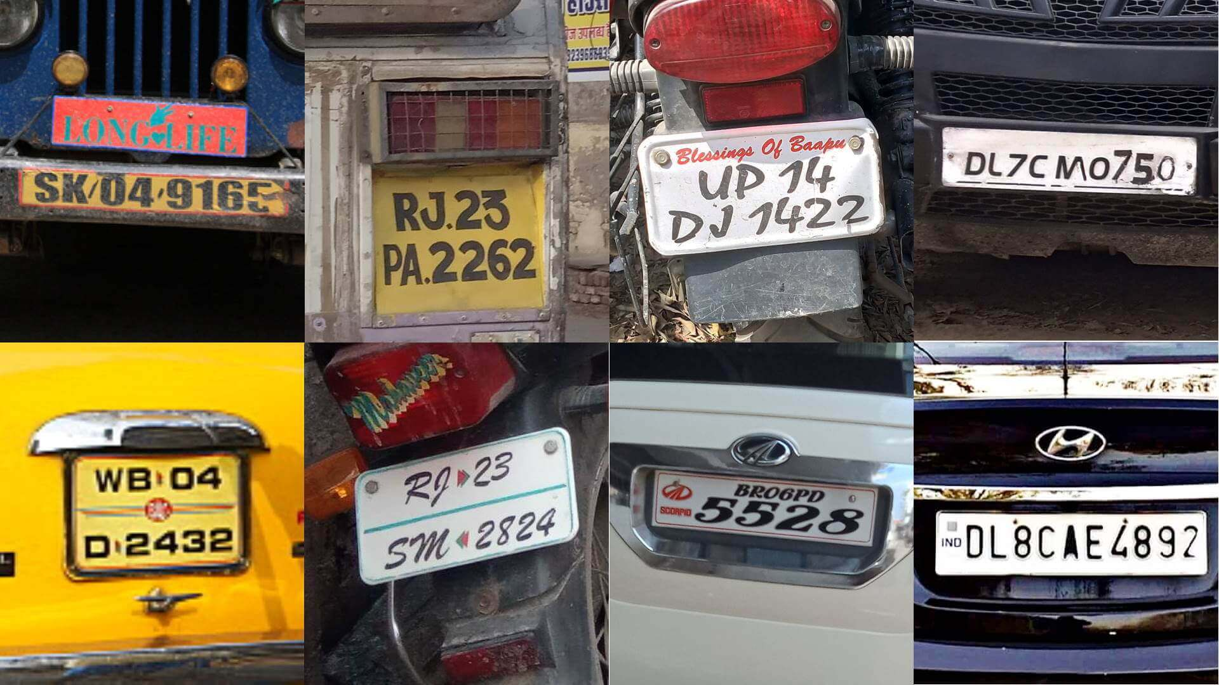
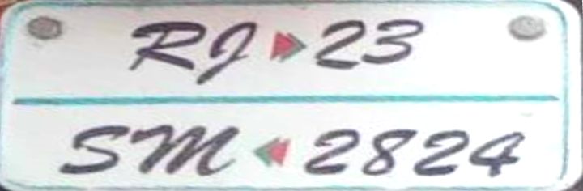
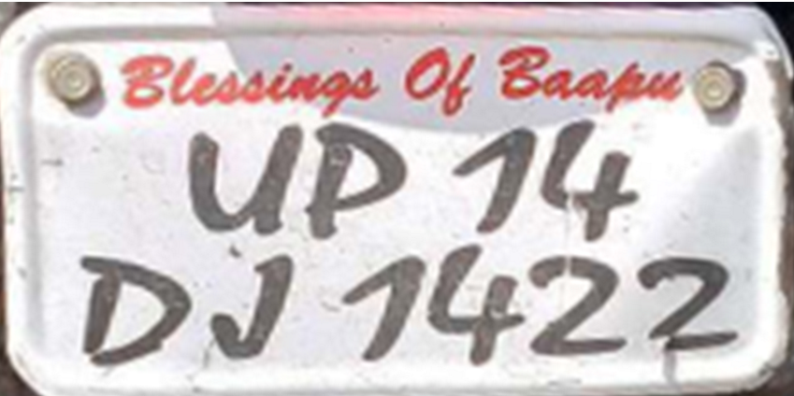




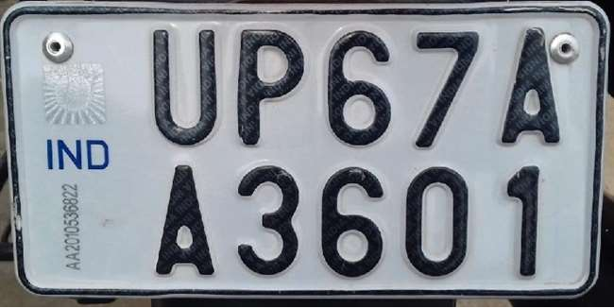



What is Machine Learning?
নমস্কার
“
“
The art and science of dealing with uncertainty
It is kind of a big deal. Remember, we want to write code to do this
R
D
L
C
Are you sure even humans would be able to do this for scripts they don’t know?
U
P
J
Big deal! humans can do this just fine!

Slide 16










When to apply ML
Complexity: no “closed form” solutions
Difficult for a human to think of all edge cases
Tedious to maintain if these keep evolving with time
Detecting spelling mistakes not a good ML problem
A simple dictionary lookup (binary search) is enough
Presence of immense variety
Too many variants to be solved independently
Correcting spelling mistakes a very good ML problem
Need for automation
Scalability and speed are main criterion
Do we need to automate medicine, driving?
macine
macine
machine

Slide 17
Why is it called “Machine” Learning?
The “Machine”
INPUT
OUTPUT
4
9
1
7
5
5
Code
9
4
3
3
7
Bubble Sort, Quick Sort, Heap Sort, etc.
Written by a human coder
2
2
1
The non-ML way to solve a well-understood task

Slide 18
Why is it called “Machine” Learning?
TESTING
The “Machine”
TRAINING
Code
Code
ML Algorithm
Written by a human ML expert
ML model
Produced automatically by the ML algo
TRAINING DATA
The ML way to solve an ill-understood task
Instead of writing code directly, supply examples, write “meta” code to generate the final code

Slide 19
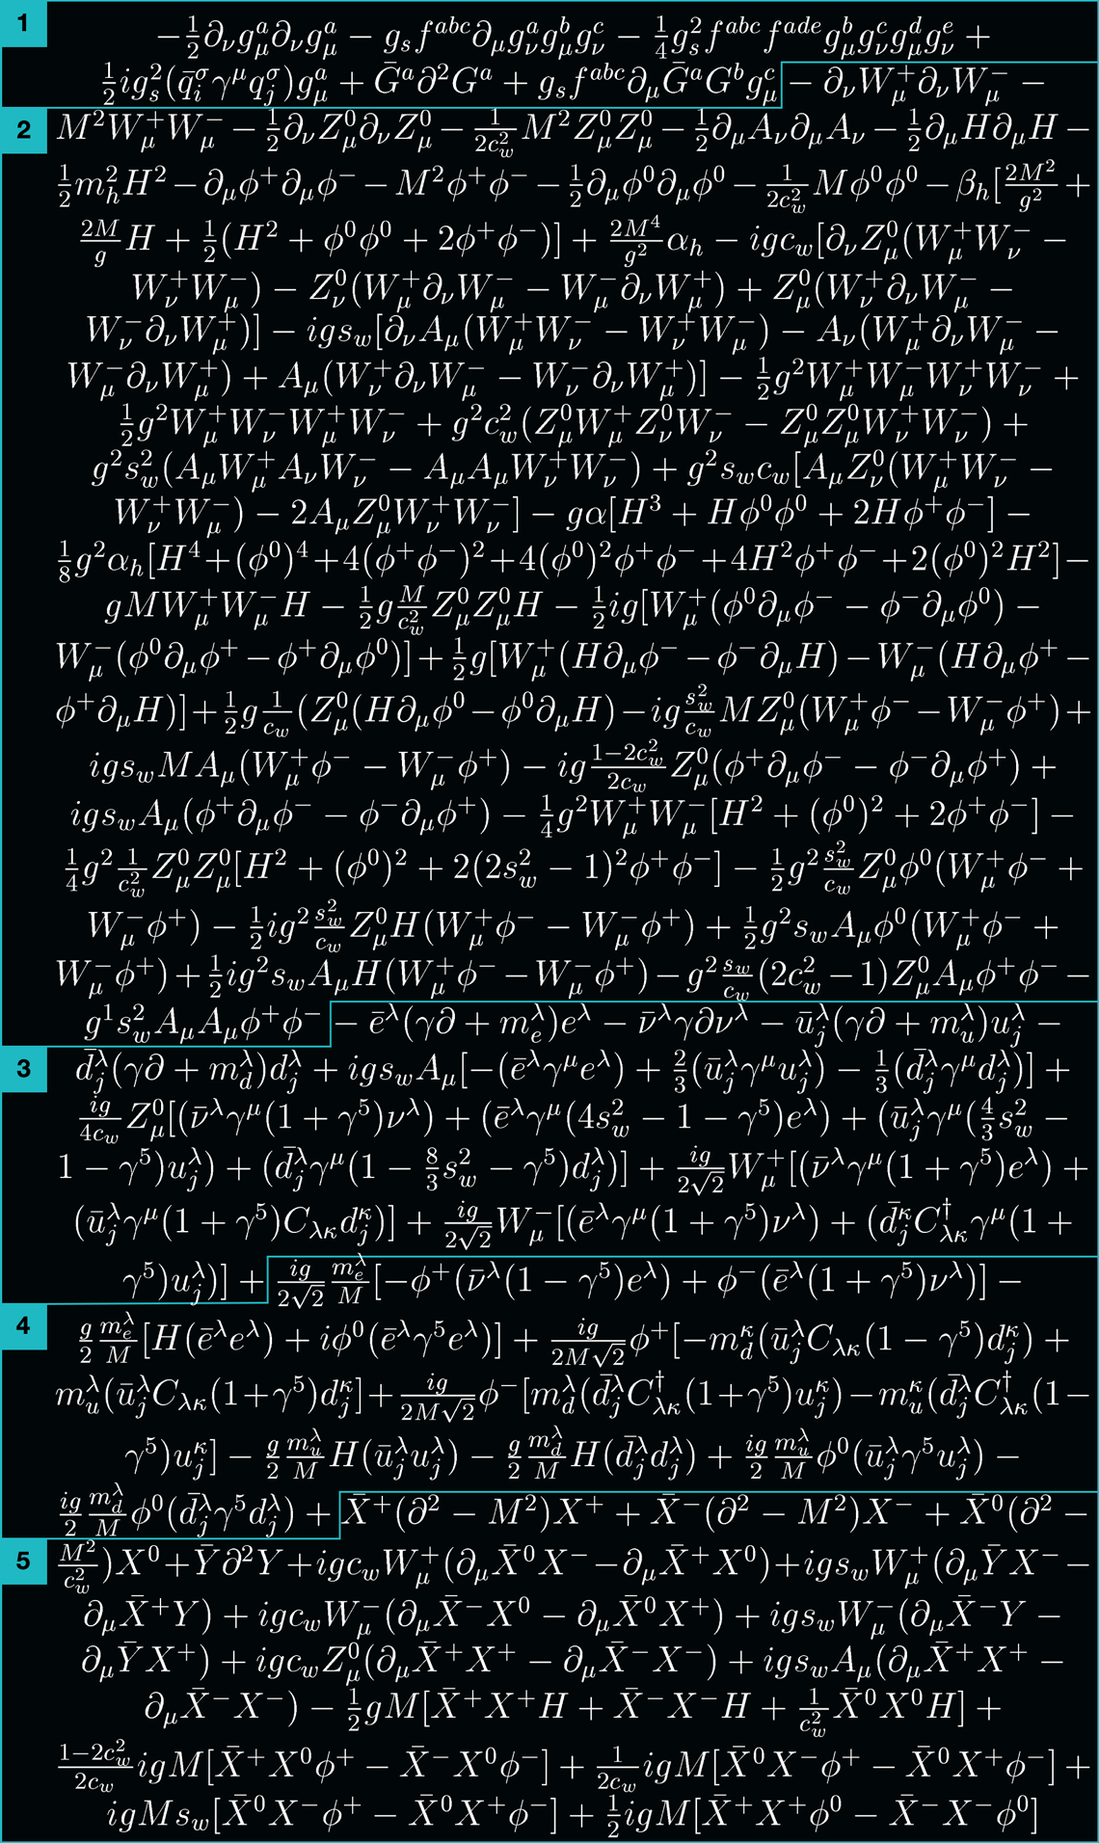



Under the Hood – how ML works
THE STANDARD MODEL
Nature is governed by laws
Humans are sometimes able to discover these
However, it usually takes a lot of effort
More importantly, a lot of time (years/decades)
$$E= mc^{2}$$
Some are concise and elegant
Others are … well …
businessinsider.com

Slide 20







Under the Hood – how ML works
Even ML works by discovering laws
Inspect data and discover laws/patterns that seem to explain data well
$= ≈ + ⇒$ P
FEMALE, 25-30 YRS, HIGH INCOME $⇒$
MALE, 18-25 YRS, MID INCOME $⇒$
$= ≈ + ⇒$ L
MALE, 30-45 YRS, LOW INCOME $⇒$
Remember, this is just an illustrative example. Not all “laws” learnt by ML look like this
ML is able to discover more complex laws more quickly than humans
Indeed! In fact, most patterns and laws learnt by ML are too complex to be interpreted easily

Slide 21
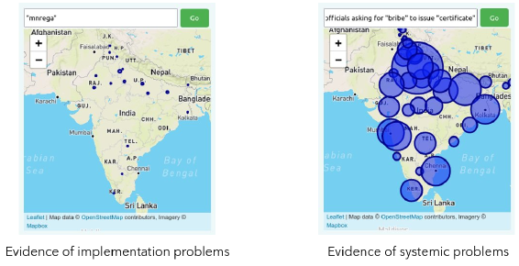
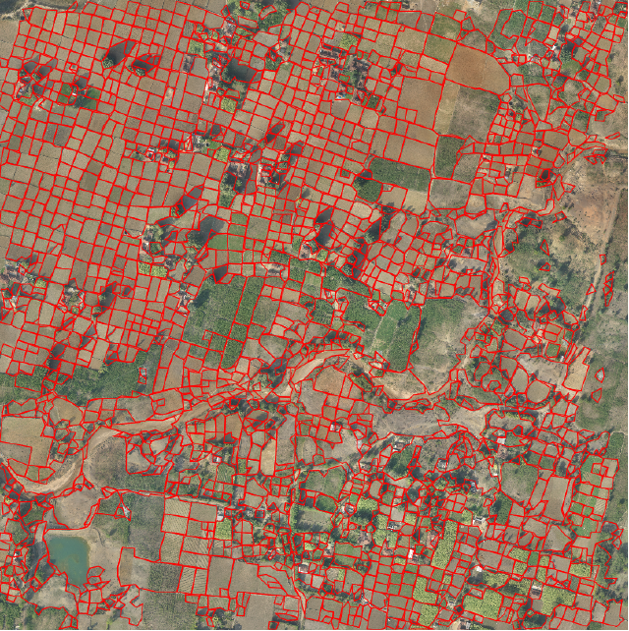
ML for e-Governance
A novel search engine for public grievances at the MoD
Emergency warning / dispatch systems
Accountability
Estimate income of citizens
Determine eligibility for public benefits services
Convert existing pull model to a push model
Automatically recognize land parcel boundaries in rural areas
Identify infrastructure damage on national highways
Assess volume of material moved at mining sites

Slide 22
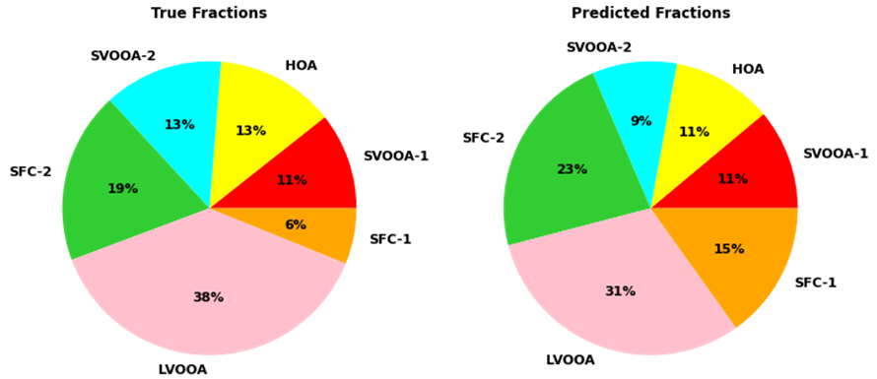
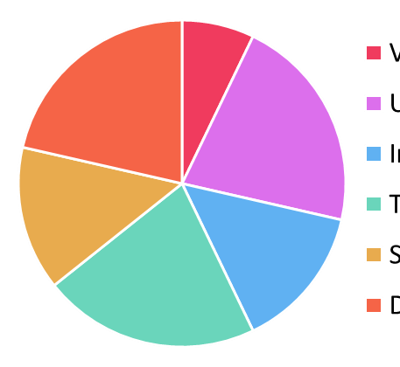
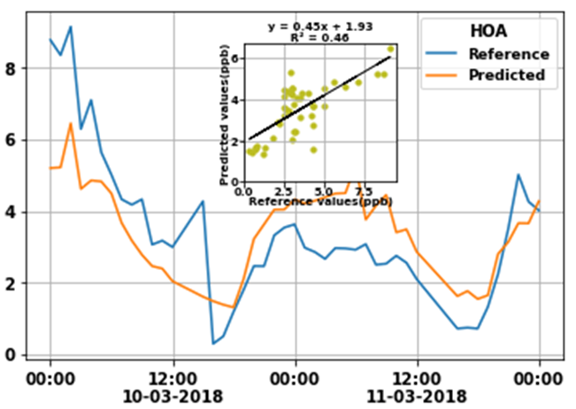
Clean Air with ML
Vehicular Pollution
Urban Organic Aerosols
Industrial Emissions
Transported Organic Aerosols
Biomass Combustion
Dust Related
An example of Hydrocarbon-like Organic Aerosol (HOA) levels predicted by a machine learning algorithm for a period of two days. The algorithm tracks well the peaks and dips in HOA levels

Slide 23



Anomaly Detection in Satellites
Fully autonomous missions a lofty goal in space exploration
Space missions still rely on ground staff support
Vast amounts of telemetry sent to mission control to be manually inspected
Expert ground staff provide remediation telecommand in case of anomaly
Early detection key to success of this setup
Enable ground staff to quickly take curative action
Critical to preserving spacecraft and mission health
Telecommand
Telemetry

Slide 24
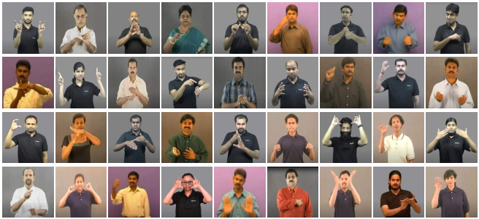
Sign Language Understanding

Slide 25
Program Correction with ML
IITK offers a C programming course to ~1000 students each year
#include <stdio.h>
int main(){
int a;
scanf("%d", a);
printf("ans=%d",a+10);
return 0;
}
#include <stdio.h>
int main(){
int a;
scanf("%d", &a);
printf("ans=%d",a+10);
return 0;
}
Line-4, Column-9: warning: format ‘%d’ expects argument of type ‘int *’, but argument 2 has type ‘int’

Slide 26
Program Correction with ML
IITK offers a C programming course to ~1000 students each year
#include <stdio.h>
int main(){
int x, x1 ,d;
d=(x-x1)(x-x1);
return d;
}
#include <stdio.h>
int main(){
int x, x1 ,d;
d=(x-x1)*(x-x1);
return d;
}
Line-4, Column-11: error: called object type ‘int’ is not a function or function pointer

Slide 27
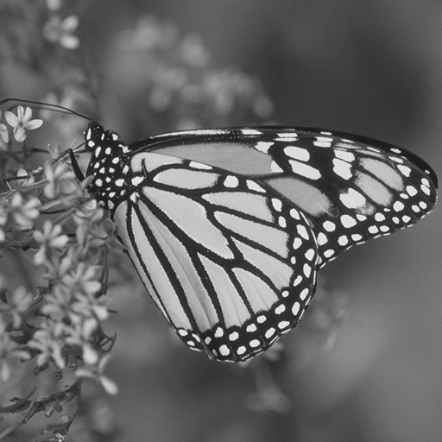
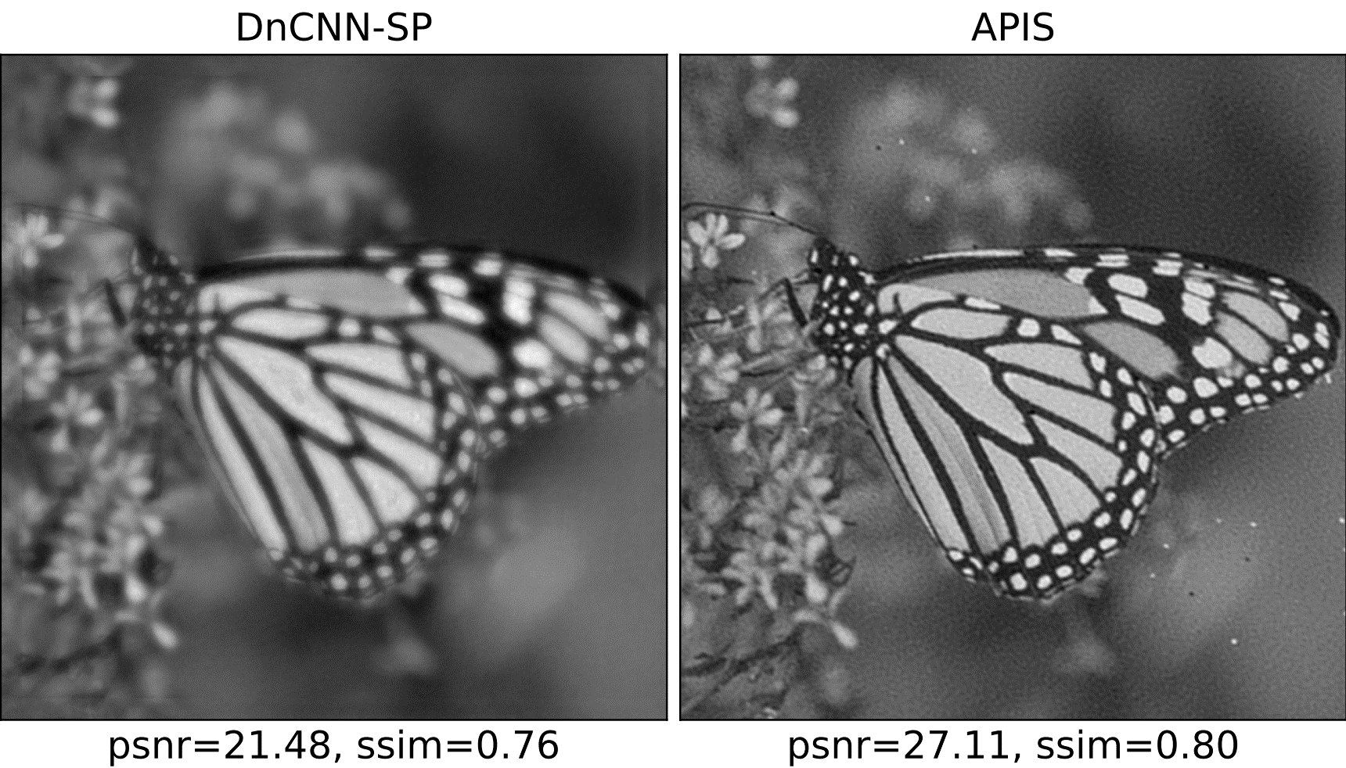
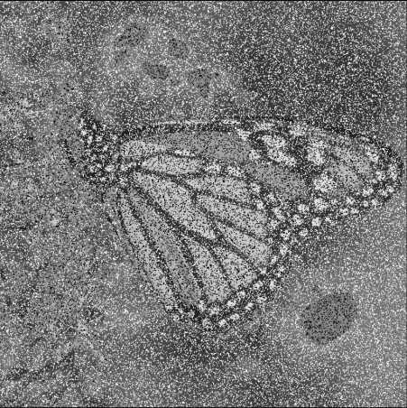
Image Denoising
Original
Poisoned

Slide 28
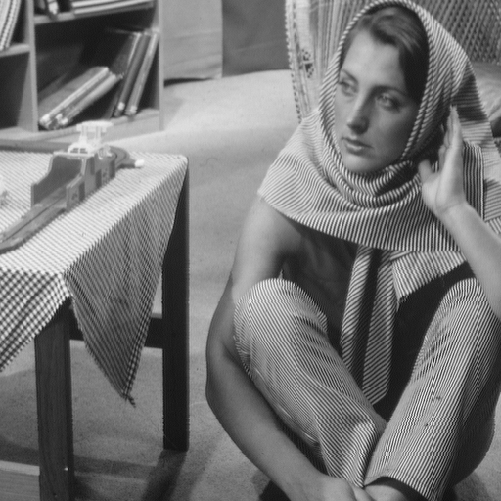
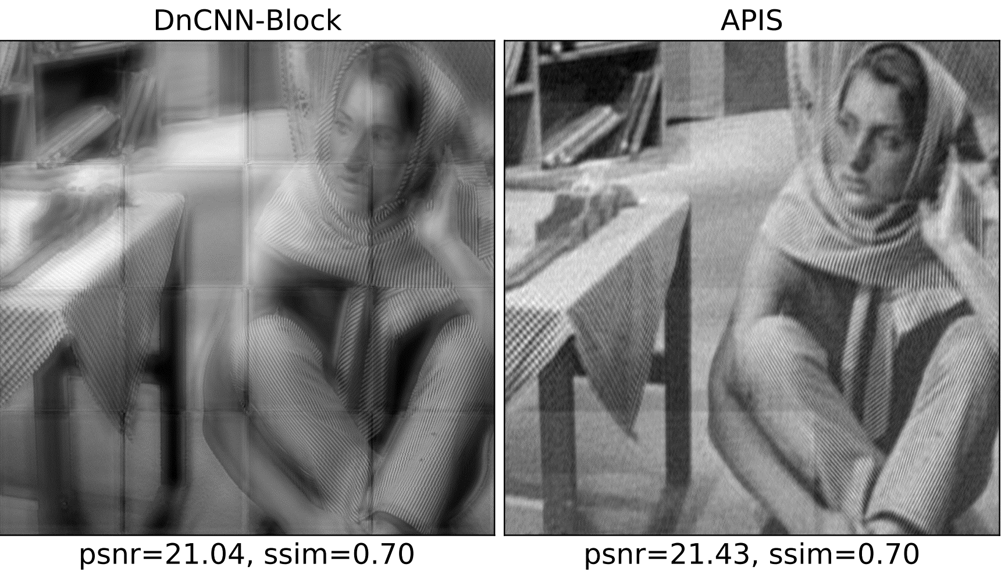
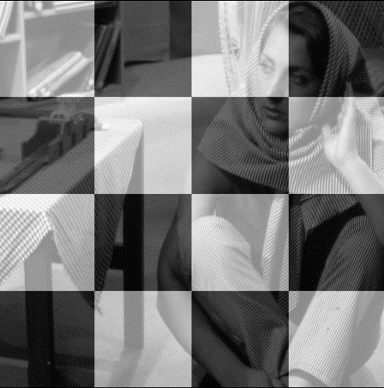
Image De-watermarking
Original
Poisoned

Slide 29

ML and CYS
ML → CYS: Beyond rule-based CYS
Zero-day attack prevention
Reduce false-positive nuisance
Vulnerability detection
Intrusion detection
Malware analysis
CYS → ML: Protecting data, models
Robust learning
Steganography, watermarking
Exfiltration protection
Privacy-preserving ML
Unfair use prevention

Slide 30




Reveal Cybersecurity Vulnerabilities

Slide 31
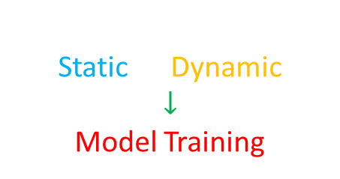
Malware Detection via Behavioral Analysis
TESTING
Most critical
TEST
TEST
TEST
TRAINING
A.EXE
B.SYS
C.COM
Feature Extraction
Static Dynamic
$$↓$$
Model Training
Model
D.TXT
E.PY
SAMPLE FILES
Static: 97.95% (4s)
Dynamic: 99.13% (8s)
Hybrid: 99.74% (12s)
FPR: 0.1%
BENIGN / MALWARE
BENIGN / MALWARE
BENIGN / MALWARE

Slide 32

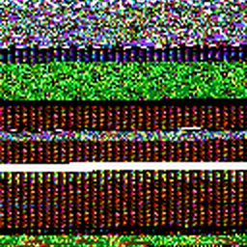

Feature Engineering for Malware Detection
Use memory dumps (memory forensics) as features
Can reveal features not available to dynamic analysis e.g. hidden processes, hidden DLLs, code injection.
Kumar, A., Gupta, M., Kumar, G., Handa, A., Kumar, N., & Shukla, S. K. (2020). A review: malware analysis work at IIT Kanpur. Cyber Security in India, 39-48.
Represent binary files as images
Use computer vision models
CNN: 98.98%
ResNet-50: 99.40%
Singh A., Handa A., Kumar N., Shukla S.K. (2019) Malware Classification Using Image Representation. In: Dolev S., Hendler D., Lodha S., Yung M. (eds) Cyber Security Cryptography and Machine Learning. CSCML 2019. Lecture Notes in Computer Science, vol 11527. Springer, Cham.
Trojan:startpage
Virus:Krepper
Backdoor:Rbot

Slide 33
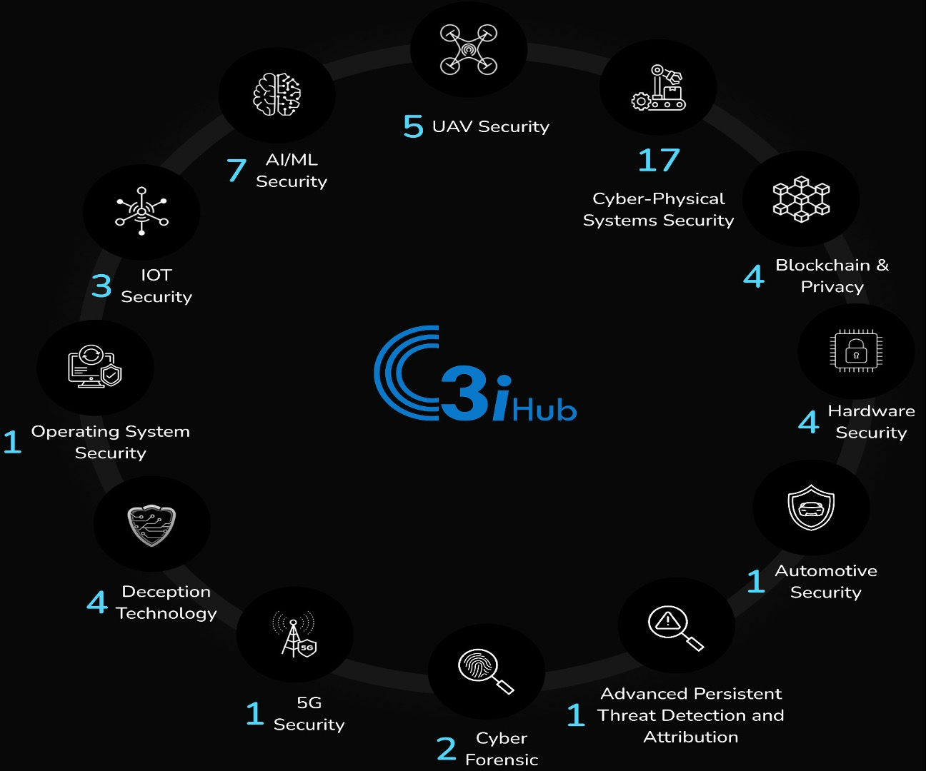
C3i Malware Analysis Tool Pathways
Windows malware classification
Linux malware detection
Android malware detection
PDF malware detection
DOC/DOCX malware detection
JS malware detection
JPEG malware detection
Botnet detection

Slide 34
Stay Awesome!
See you in the next one

